Slide 1
Organization Wide
Daily Safety Huddle
Terry Sievers, MS, RN, CPHQ, CPHRM
Vice President, Quality, Risk Management & Patient Safety

Slide 2

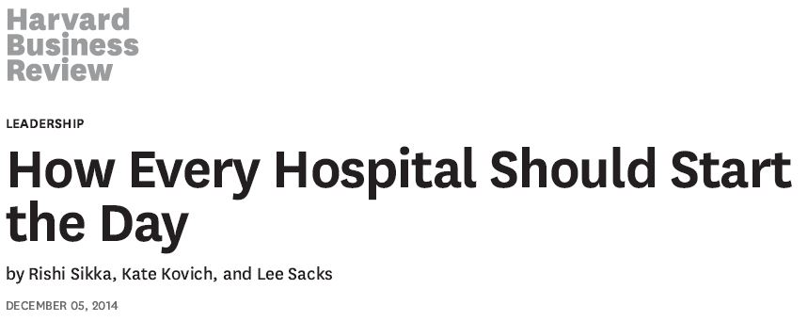
Daily Safety Huddle

Slide 3
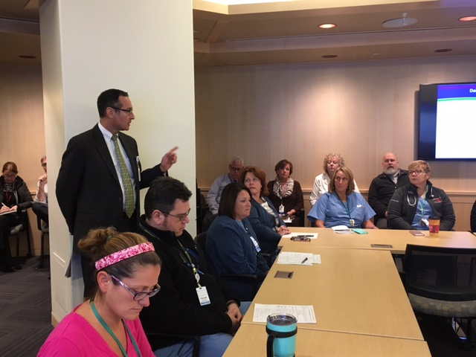
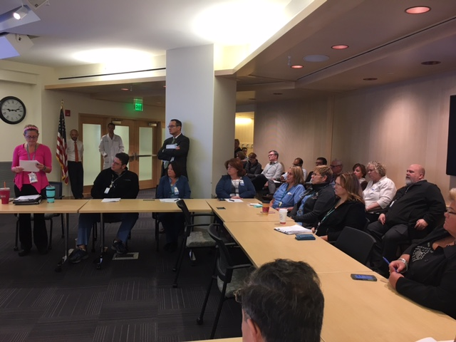
Daily Safety Huddle
HHS Initiated the organization-wide daily safety huddle 9/12/17
Brought together 3 groups already conducting daily huddles: nursing, case management and senior leadership
Daily Monday-Friday 9:00 – 9:30 am
Connects leaders with work occurring throughout the hospital, focuses leaders on helping the front lines do their best work, and helps drive the organization-wide culture change needed to improve safety and quality across the board.

Slide 4
Participation
Approximately 50 leaders across the health system participate in person or via phone
CEO, CFO, COO, CNO, CMO, VPs, physicians
Departmental leaders in clinical and non-clinical areas, off-site clinical areas, VNA/Home Care and Hospice, physician office practice leadership
Invited Board of Trustee members
Invited residents, nursing and pharmacy students

Slide 5
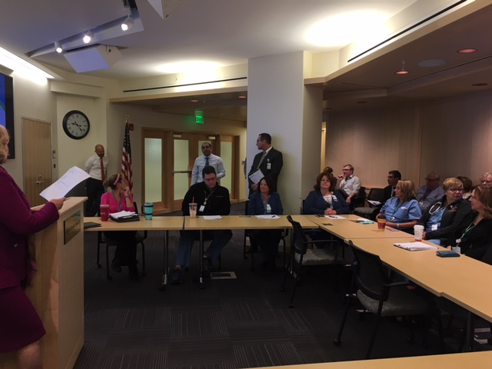
Reporting Process
  Initiate Huddle with welcome and statement:
  “Our shared vision is to provide the highest quality, evidence-based compassionate care and prevent and reduce patient harm”
  Next:
  Report on Serious Safety Events and Other Issues that Need Daily Focus

Slide 6
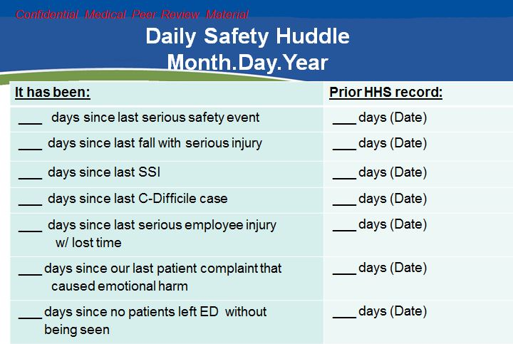
Report on Serious Safety Events

Slide 7
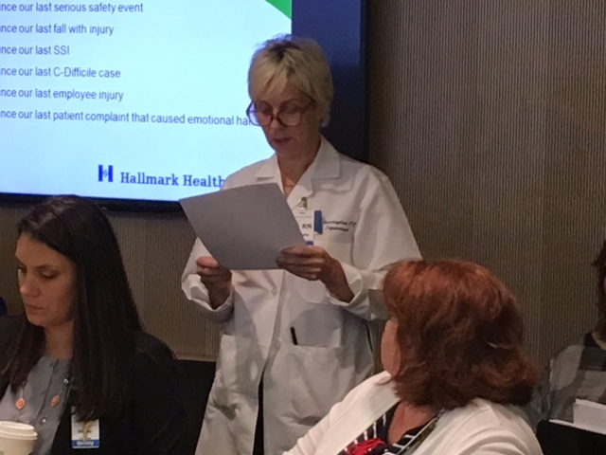
Dept./Unit Reports
Clinical and non-clinical leaders report out on volume, staffing, patients with “devices” such as central venous catheters and urinary catheters, patients expected to be discharged, on safety, quality and service events in the past 24 hours.
Leaders report on good catches and staff recognition.
All areas report on any other issues, needs, and concerns.

Slide 8
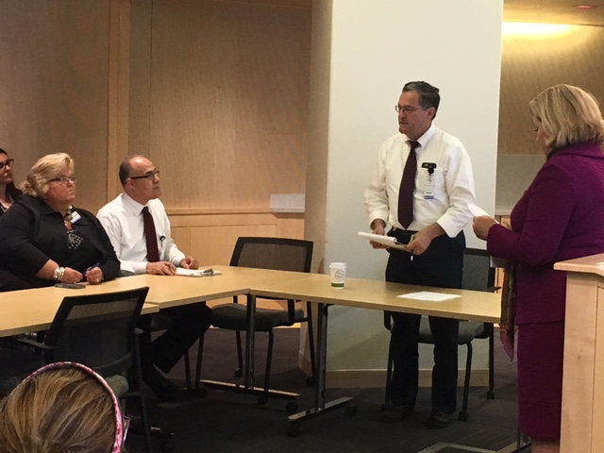
Department and Unit Reports
  Report-outs on the following within the past 24 hours:
  current volume / budgeted volume
  Staffing / needs or issues
  patients with “devices”
  patients expected to be discharged
  equipment and housekeeping needs
  safety issues
  incident reports (RL6)
  turnaround times
  anticipated issues

Slide 9
Reporting Process
Report on any issues, needs or concerns in the next 24 hours
Report any expected or known regulatory visits
Announcements and “Shout Outs”
Risk Management and Quality facilitate collaboration and immediate follow up on rL safety reports

Slide 10
Daily Safety Huddle Supports Teamwork, Safety Culture and Accountability
Promotes rapid resolution of safety events, as departments report out on what happened in the last 24 hours, and usually have completed an initial investigation in order to provide information during the report out
Connects leaders with work occurring throughout the system
Focuses leaders on helping the front lines do their best work
Promotes transparency
Promotes focus on just culture when discussing safety events
Provides a forum for sharing good news, awards, good catches
Drives organization-wide culture change

Slide 11
Improvements Noted (Page 1)
Real time interdepartmental communication and problem solving
Reporting on patient flow from ED to inpatient units (pull vs push)
Decrease in reported urinary catheters
Reporting on expected removal of catheters
Reporting on expected discharges and those needing physician order
Reporting on transport time
Reporting on Environmental Services room turnover time

Slide 12
Improvements Noted (Page 2)
5% increase in reporting RL6 safety reports
77% decrease in average time to close an RL6 safety report
Eliminated C. diff cases that were present on admission, followed by C. Diff cases due to inappropriate testing (after laxative)
Increase in the number of patients discharged before 11 am
Development of the IPASS handoff tool for patients being admitted to an inpatient unit from the emergency department

Slide 13
Improvements Noted (Page 3)
Respiratory therapy adopted a modified IPASS handoff tool to use during shift changes
Appropriate use of sitters and interpreters
Increased awareness of ED patients “holding” for an inpatient bed
Increased awareness of budgeted vs. daily volume of inpatients, ED patients, surgical procedures and outpatient visits
Increased awareness of patients with central lines and urinary catheters

Slide 14
Improvements Noted (Page 4)
Real-time collaboration to solve complex medical needs of patients
Facilities reports on areas impacted by construction, increasing awareness of “above ceiling permits”
Announce weekly environment of care rounds immediately following the daily safety huddle

Slide 15

Questions
tsievers@hallmarkhealth.org

